Slide 1
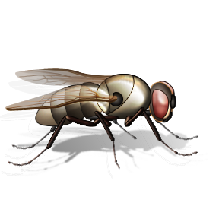
Lord of the Flies
By William Golding

Slide 2
Background
Published in 1954
Do you remember what was happening in the 1950’s as discussed with Fahrenheit 451?

Slide 3
What is it about?
British schoolboys, ages 6-12 survive a plane crash on a small island during an atomic war.
No Adult Survivors (anywhere?)

Slide 4
What happens?
The boys create a small society that reveals all that the author believes about mankind.
They assemble for “meetings” by blowing a conch.

Slide 5
Themes of the Novel
The goodness or evil of mankind
The breakdown of society
The breakdown of moral standards
The defects of society
Human nature
Government vs. the individual

Slide 6
The Movie
Many differences- do not rely on it.

Slide 7
William Golding
When William Golding (1911-1993) was awarded the Nobel Prize for Literature in 1983, the Nobel Foundation cited:
"his novels…illuminate the human condition in the world of today".
(www.william-golding.co.uk)

Slide 8
Allegory
An allegorical novel- characters, events, objects, and ideas have secondary or symbolic meanings.
Think of something that happens in everyday life that is allegorical (an event, gesture, object, idea)

Slide 9
Your essay prompt:
Choose a character from Lord of the Flies and make a statement about him. In a well-developed 5 paragraph essay, prove what you have to say about the character by using examples and quotes from the book.

Slide 10
“A” Quality Thesis
William Golding uses the character of Jack in Lord of the Flies to show how the thirst for power will lead to mankind’s ultimate demise.

Slide 11
“A” Quality Thesis
The character, Piggy, in Lord of the Flies exemplifies the virtues that are possessed by all of mankind: kindness, generosity, and forgiveness.

Slide 12
“A” Quality Thesis
In Lord of the Flies by William Golding, Jack symbolizes mankind’s continual struggle with temptations, particularly the temptation to tear others down in order to build oneself up.

Slide 13
“C” Quality Thesis Statements
Ralph is a cruel character.
Piggy is always picked on by the other characters.
Jack becomes the leader because he is charismatic, strong, and brave.

Slide 14
Try this:
In William Golding’s Lord of the Flies, ________ is a _________, _________ character who represents ___________________________ in all of mankind/ in society.

Slide 15
Or this:
William Golding writes the character of _________ in Lord of the Flies to show __________________________________________________________________________.

Slide 16
Or this:
In William Golding’s Lord of the Flies, the character _________ teaches the reader that _____________________________________
___________________________________.

Slide 17
Or maybe this:
The idea that __________________________
______________________________________________________________________________is shown through the character ________ in William Golding’s Lord of the Flies.

